Slide 1
COSC 606: Homework 2 Results
By - Adarsh Ghimire (100058927)
06 MARCH 2021

Slide 2
Batch Gradient Descent on MNIST Dataset Details and Results
Network Details | Network 1 | Network 2 | Network 3
Hidden Layers / Neurons | 1 / 64 | 2 / 64, 32 | 3 / 64, 32, 32
Network Initialization | Xavier | Xavier | Xavier
Learning rate | 1.0 | 1.0 | 1.0
Epochs | 4000 | 4000 | 4000
Training data size | 54,000 | 54,000 | 54,000
Validation data size | 6,000 | 6,000 | 6,000
Test data size | 10,000 | 10,000 | 10,000
Hidden layers activation | Sigmoid | Sigmoid | Sigmoid
Output layer activation | Softmax | Softmax | Softmax
Loss | Categorical Cross entropy | Categorical Cross entropy | Categorical Cross entropy
Training Accuracy (%) | 96.68 | 97.24 | 97.23
Validation Accuracy (%) | 96.83 | 97.10 | 96.31
Test Accuracy (%) | 96.08 | 96.26 | 95.94
Test Error Rate (%) | 3.920 | 3.740 | 4.060

Slide 3
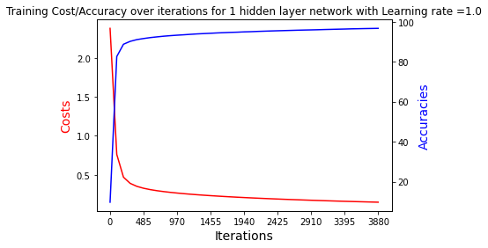
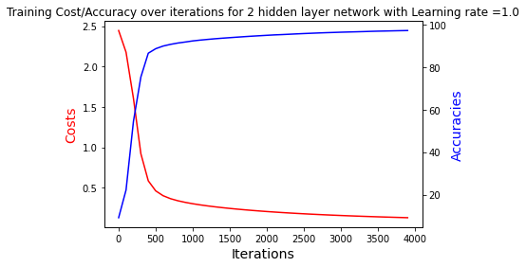
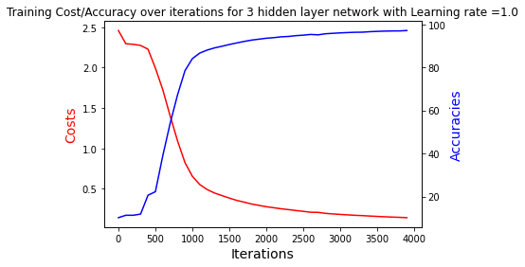
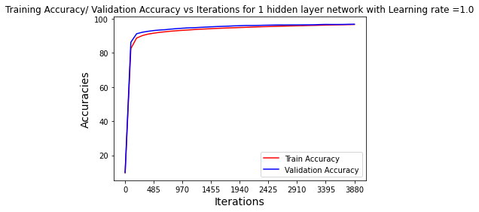
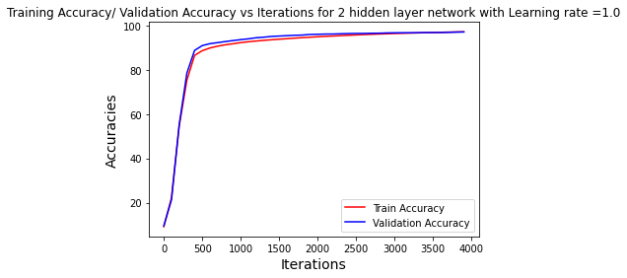
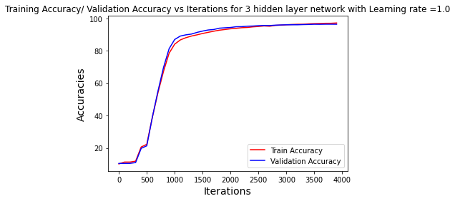
Network Convergence Graph
Network 1
Network 2
Network 3

Slide 4
Mini-Batch Gradient Descent on MNIST Dataset Details and Results with Sigmoid
Network Details | Network 1 | Network 2 | Network 3
Hidden Layers / Neurons | 1 / 64 | 2 / 64, 32 | 3 / 64, 32, 32
Network Initialization | Xavier | Xavier | Xavier
Learning rate | 1.0 | 5.0 | 1.0
Epochs | 100 | 500 | 100
Batch Size | 128 | 128 | 128
Training data size | 54,000 | 54,000 | 54,000
Validation data size | 6,000 | 6,000 | 6,000
Test data size | 10,000 | 10,000 | 10,000
Hidden layers activation | Sigmoid | Sigmoid | Sigmoid
Output layer activation | Softmax | Softmax | Softmax
Loss | Categorical Cross entropy | Categorical Cross entropy | Categorical Cross entropy
Training Accuracy (%) | 99.41 | 99.03 | 99.67
Validation Accuracy (%) | 97.77 | 97.13 | 97.46
Test Accuracy (%) | 97.64 | 96.48 | 97.03
Test Error Rate (%) | 2.360 | 3.520 | 2.970

Slide 5
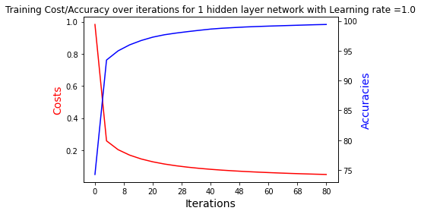
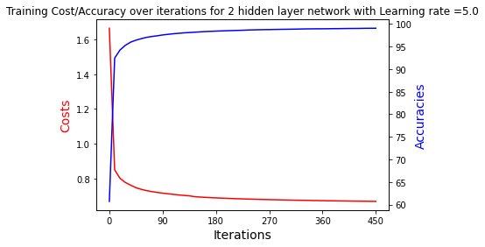
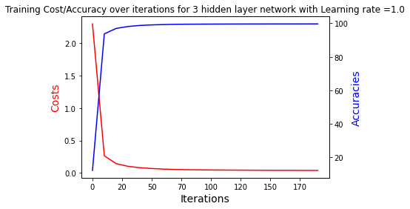
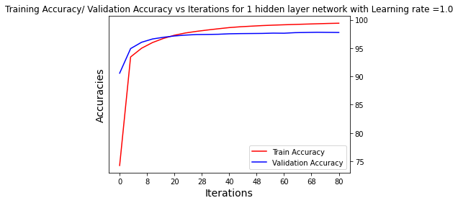
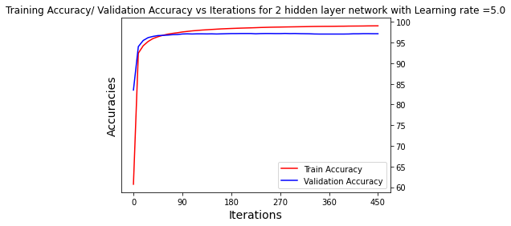
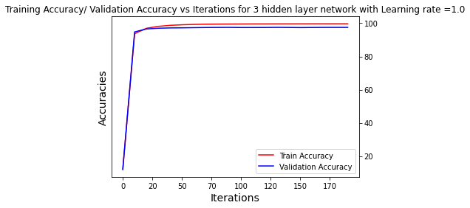
Sigmoid activated Network Convergence Graph
Network 1
Network 2
Network 3

Slide 6
Mini-Batch Gradient Descent on MNIST Dataset Details and Results with ReLU
Network Details | Network 1 | Network 2 | Network 3
Hidden Layers / Neurons | 1 / 64 | 2 / 64, 32 | 3 / 64, 32, 32
Network Initialization | Xavier | Xavier | Xavier
Learning rate | 1.0 | 1.0 | 1.0
Epochs | 100 | 100 | 100
Batch Size | 128 | 128 | 128
Training data size | 54,000 | 54,000 | 54,000
Validation data size | 6,000 | 6,000 | 6,000
Test data size | 10,000 | 10,000 | 10,000
Hidden layers activation | ReLU | ReLU | ReLU
Output layer activation | Softmax | Softmax | Softmax
Loss | Categorical Cross entropy | Categorical Cross entropy | Categorical Cross entropy
Training Accuracy (%) | 99.76 | 99.03 | 99.69
Validation Accuracy (%) | 98.02 | 97.58 | 97.83
Test Accuracy (%) | 97.60 | 97.74 | 97.40
Test Error Rate (%) | 2.400 | 2.260 | 2.600

Slide 7
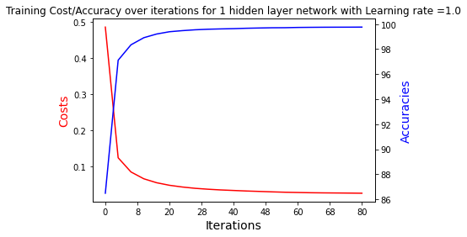
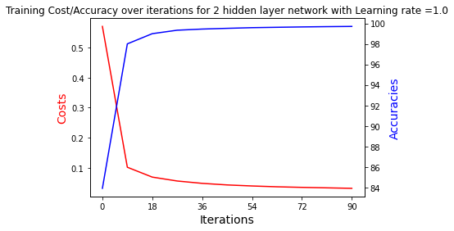
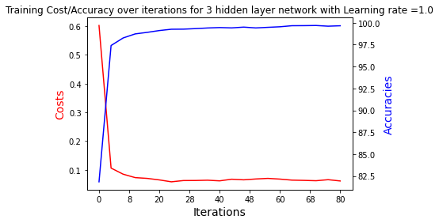
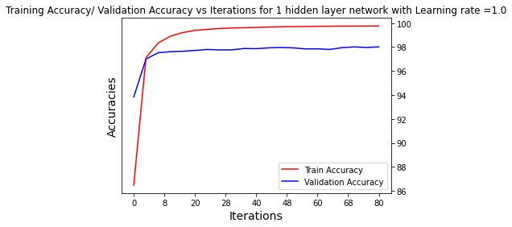
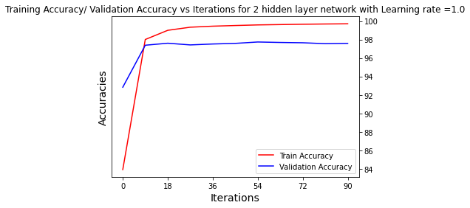
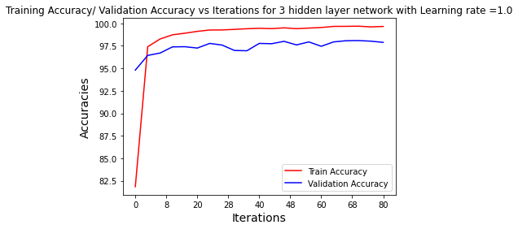
ReLU activated Network Convergence Graph
Network 1
Network 2
Network 3

Slide 8
Overall Comparison between best performing networks
Network Details | Batch gradient descent based network | Sigmoid Activated Mini-batch network | ReLU activated Mini-batch network
Hidden Layers / Neurons | 2 / 64, 32 | 1 / 64 | 2 / 64, 32
Network Initialization | Xavier | Xavier | Xavier
Learning rate | 1.0 | 1.0 | 1.0
Epochs | 4000 | 100 | 100
Batch Size | 54,000 | 128 | 128
Hidden layers activation | Sigmoid | Sigmoid | ReLU
Output layer activation | Softmax | Softmax | Softmax
Loss | Categorical Cross entropy | Categorical Cross entropy | Categorical Cross entropy
Training Accuracy (%) | 97.24 | 99.41 | 99.03
Validation Accuracy (%) | 97.10 | 97.77 | 97.58
Test Accuracy (%) | 96.26 | 97.64 | 97.74
Test Error Rate (%) | 3.740 | 2.360 | 2.260

Slide 9
Discussion
Regarding convergence rate :
Batch Gradient Descent reaches towards convergence after 3000 epochs only and the reason is quiet obvious because the network needs to update its weights by looking at overall training data.
Mini-batch Gradient Decent reaches convergence in less than 20 epochs, and the reason is because the weight updates happens for each mini batches, and it allows the network to update its weights by looking at the mini batches only at a time, resulting in overall convergence of the network in short amount of time.
Regarding Training and Validation Accuracy
In my case, Training accuracy of the batch gradient descent network is less compared to mini-batch ones, which is due to the fact that the network was trained only for 4000 epochs in case of batch gradient descent which is not sufficient enough as can be seen from the diagram, that the network loss or accuracy has not plateaued completely.
Validation and test accuracy of batch gradient descent based network is similar to training accuracy, as it can be generalized from the fact that, in batch network the whole training data is considered into account for weight updates, thus the network is more generalized during weight updates. It shows batch gradient descent network are more generalized, or does not over fit easily.
Mini-batch network training accuracy is higher than validation accuracy since the weight updates has to be done for batches only which does not generalizes more. However, the convergence in minibatch is faster, because the weight updates that happens with the help of mini-batches resulting in faster updates of weights, and convergence of the network. It shows that the mini-batch networks overfits faster and thus requires some regularizations in order to avoid overfitting.

Slide 10
Discussion
Regarding Sigmoid vs ReLU
Sigmoid vs ReLU based network, the convergence on ReLU is very fast which are less than 20 epochs for all the 1 to 3 hidden layer based network, and also the training time of the ReLU based network is also very small because of little less network complexity. Where as Sigmoid activated network minimum convergence is after 40 epochs only. In addition, the training time is also little bit more when the sigmoid was used.
ReLU activated 2 hidden layer is giving the best performance among all the networks. Sigmoid activated single hidden layer is performing best compared to 2 and 3 hidden layers based network, however the ReLU activated all 1, 2, and 3 hidden layers based network are giving very high performance i.e. test error rate of 2.4%, 2.26% and 2.6% respectively. Sigmoid activated 1,2, and 3 hidden layers based network test error rate are 2.36%, 3.52%, and 2.97% respectively.
Regarding why 3 hidden layer network did not give the best result?
3 hidden layer network should have performed the best however due to the training data size which was not sufficient to train the large number of parameters of the network thus resulted in overfitting, and also the network suffered from vanishing gradient problem.
Regarding Overall test-error rate vs State of the art results
My optimal model is ReLU activated, 2 hidden layer based network with test error rate of 2.260%, however the state of the art results are less than 1%. The reason for state of the art results to be higher than mine is because those models are using Convolutional Neural Networks for feature extraction from the images, however, I am only using MLP at pixel level.

